Slide 1
English 2 July 15
Max Keenan

Slide 2
Attendance
What is your favorite type of pet? Explain why with an example from your life.

Slide 3
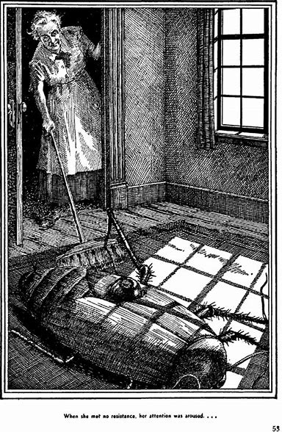
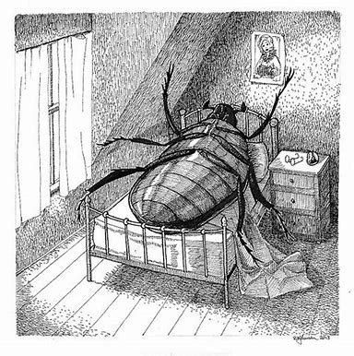
The Metamorphosis

Slide 4
Because his family has pity for him, Gregor's family decides to do what so that he may still be part of the family?
They keep the door open so that he may watch them.

Slide 5
How do the family’s activties change to accommodate Gregor’s new condition?
Gregor is kept in his room and fed by Grete. The family members begin to work. Mr. Samsa ends his retirement and takes a job as a bank messanger (remember his nice new uniform!). Mrs Samsa does sewing work and serves the three lodgers the faamily takes in. Grete works as a salesgirl (same job Gregor had!).

Slide 6
What happens when Greta gives a violin recital for the three lodgers?
Gregor, who has been kept out of sight of the lodgers, cones out to listen to the music. The lodgers are first amused (they think Gregor is funny). Then the lodgers become angry and say they will leave without paying. Grete then tells her parents Gregor must be gotten rid of. Gregor hears and agrees with his sister. He dies in his room as the sun rises the next morning.

Slide 7
By the end of the story, what percent is Gregor a bug and what percent is he still human?

Slide 8
Do you think Gregor actually turned into a bug or the whole metamorphosis was all in his head?
He was really a bug because… the whole story says he is a bug. His descriptions of being a bug seem very true.
He was never really a bug because… he was nervous and stressed he had a mental breakdown and imagined himself as a bug. His family was so materialistic they would have thrown a bug away but you can’t throw away a human.

Slide 9
Would the story be different if gregor changed into a different animal?
Yes, the story changes: dog, cat, monkey, tiger, rabbit, fish…
No, the story doesn’t change: mouse, rat, bee, ant, snake, pig…

Slide 10
Reading quiz!

